Slide 1

A project presentation on
Implementation of the AES 128 bit encryption/decryption on FPGA
Submitted by:
Himanshu Kumar
Kritika Kirthalya
Rohit Prakash
Under the guidance of
Dr. Shweta Tripathi
Department o f Electronics and Communication Engineering
MOTILAL NEHRU NATIONAL INSTITUTE OF TECHNOLOGY
ALLAHABAD-211004

Slide 2
CONTENTS
Introduction
AES encryption algorithm
Advantages of FPGA implementation
Keyboard interfacing
Alphanumeric LCD interfacing
Results
Tools Used
References

Slide 3
Introduction
As the world going through the era of information Technology Data security has become a major issue.
To protect the data from hackers some crypto graphical algorithms are required.
AES stand for Advance Encryption Standard.
Rijndael is the selected (NIST competition) algorithm for AES (advanced encryption standard).
Now standardized as FIPS-197

Slide 4
Continued…..
It is a block cipher algorithm, operating on blocks of data.
It needs a secret key, which is another block of data.
Encryption is the process of converting data(plain text) into unintelligible form (cipher text) and vice-versa Decryption.
AES Performs encryption and the inverse operation, decryption (using the same secret key) so it is called symmetrical algorithm.

Slide 5
Continued…..
It reads an entire block of data, processes it in rounds and then outputs the encrypted (or decrypted) data.
Each round is a sequence of four inner transformations.
The AES standard specifies 128-bit data blocks and 128-bit, 192-bit or 256-bit secret keys.

Slide 6
AES Encryption Algorithm
encryption algorithm
structure of a generic round
PLAINTEXT
SECRET KEY
INPUT DATA
ROUND 0
ROUND KEY 0
SUBBYTES
ROUND 1
ROUND KEY 1
SHIFTROWS
KEY SCHEDULE
MIXCOLUMNS
ROUND 9
ROUND KEY 9
ROUND KEY
ADDROUNDKEY
ROUND 10
ROUND KEY 10
OUTPUT DATA
ENCRYPTED DATA

Slide 7
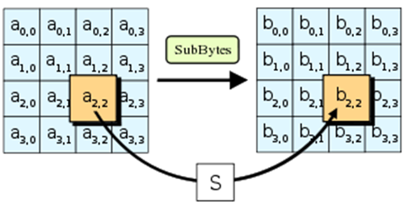
Steps in AES encryption Algorithm
1. The SubByte Step
In this step every byte in the input data state array is replaced by another byte .

Slide 8
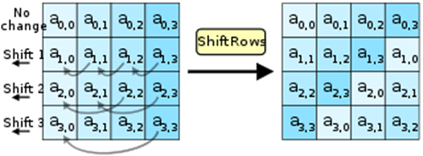
2. The ShiftRow Step
Input state array is cyclically shifted left. First row remain the same , second is shifted by one unit and so on third and fourth. For inverse shiftRow row are shifted right.

Slide 9
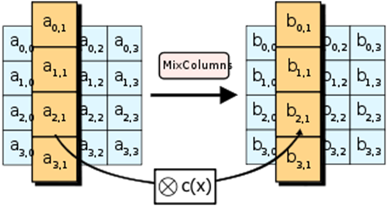
3. The MixColumns Step
In this step each column in the state array is treated as four term polynomial, multiplied by polynomial c(x)= {03}x^3+{01}x^2+{01}x+{02} in the finite field . Inverse mixcolumn can be implemented by multiplying four term polynomial c(x)= {0b}x^3+{0d}x^2+{09}x+{0e}

Slide 10
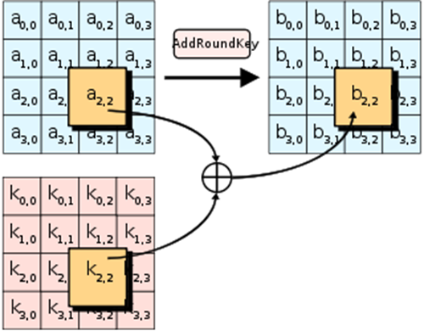
4-AddRound key step In this step round key is bitwise XORed with the state array. This step remain same for encryption as well as decryption

Slide 11
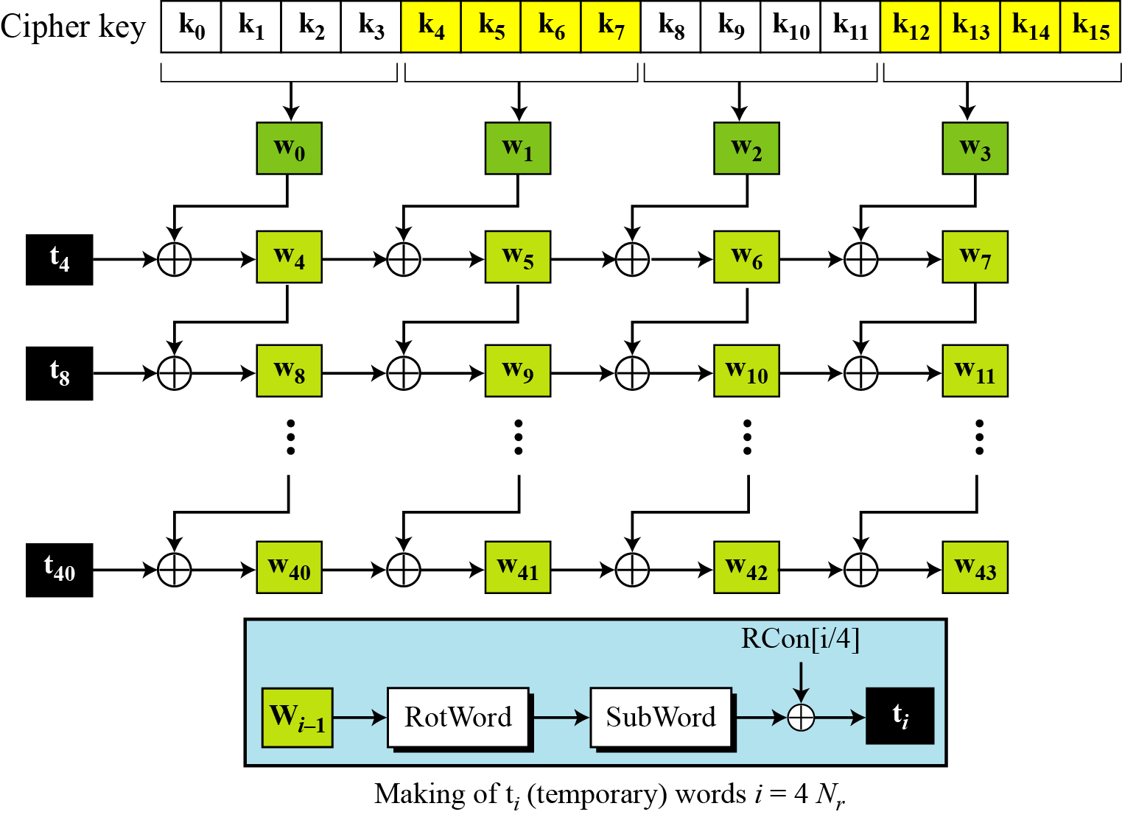
5-Key expansion step
For different round different key is used
Key for each round can be generated by the key used in the previous round.

Slide 12
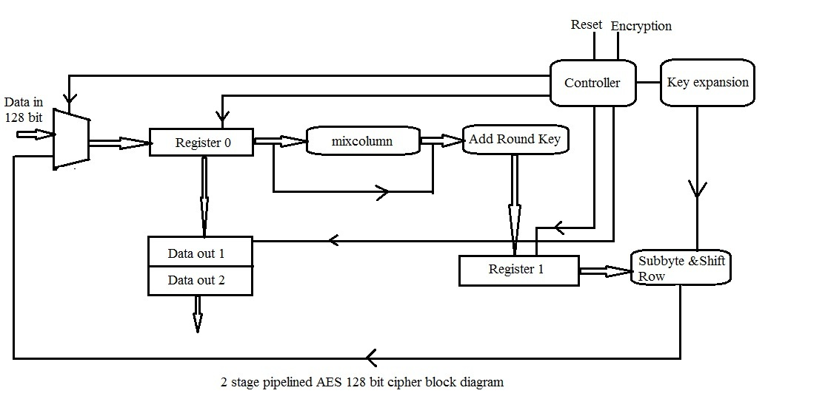

Slide 13
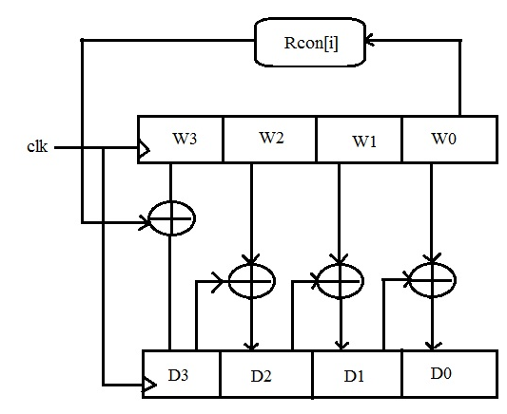
Routine for Key Expansion

Slide 14
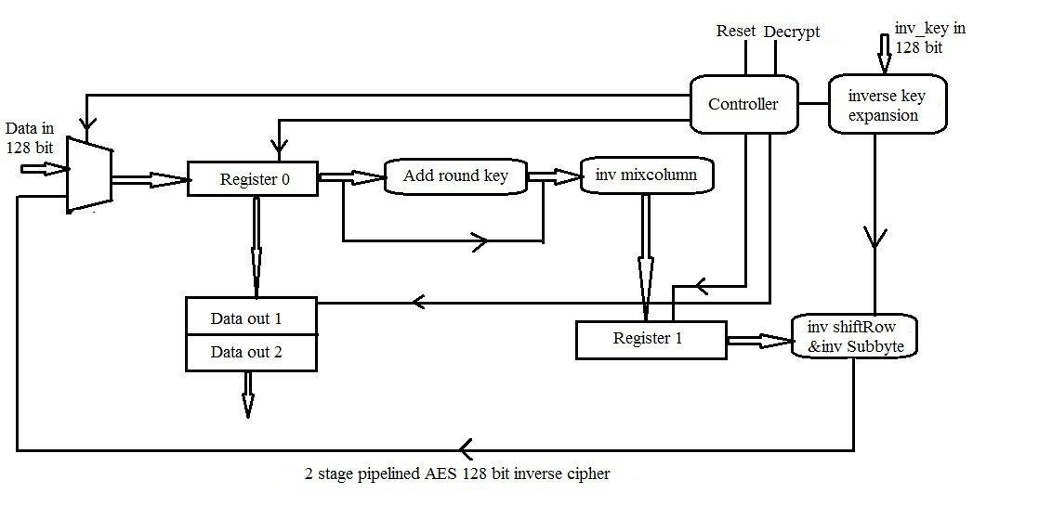

Slide 15
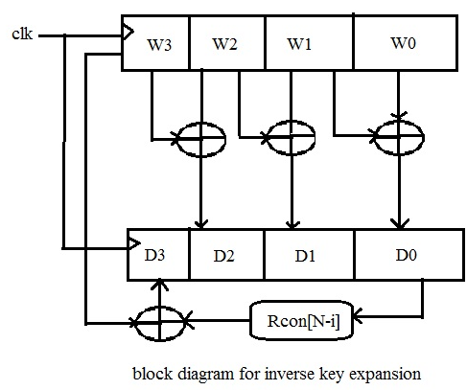
Routine for inverse key expansion

Slide 16
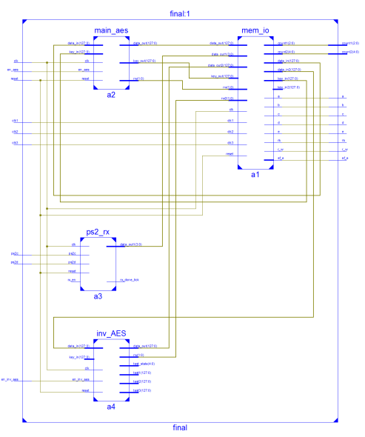
Schematic Diagram

Slide 17
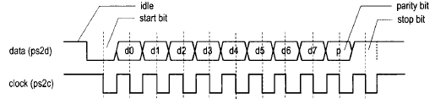
Ps2 keyboard interfacing
When any key is pressed keyboard send ASCII code of that key(make code) ,if key is held down continuously the make code is transmitted continuously and when the key is released it send the break code of that key.
Break code of some comman keys is F0 followed by make code of that key.

Slide 18
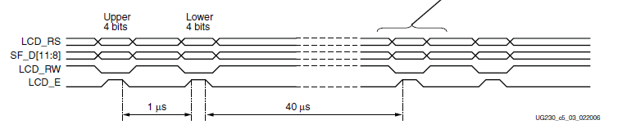
Alphanumeric LCD interfacing
The board uses a 4-bit data interface to the character LCD.
following figure illustrates a write operation to the LCD, showing the minimum times allowed for setup, hold, and enable pulse length relative to the 50 MHz clock (20 ns period) provided on the board.

Slide 19
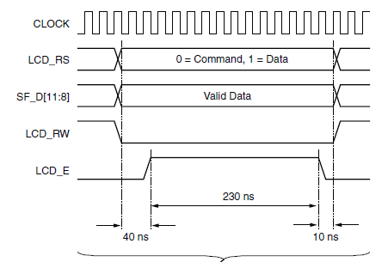

Slide 20
Advantages of using FPGA
On a Pentium Pro, AES encryption requires 18 clock cycles per byte, equivalent to a throughput of about 11 MB/s for a 200 MHz processor.
On a 1.7 GHz Pentium M throughput is about 60 MB/s.
On Intel Core i3/i5/i7 CPUs supporting AES-NI instruction set extensions, throughput can be over 700 MB/s per thread

Slide 21
Continued…
On FPGA throughput can be in the order of Gbps .For 50 Mhz clock with 2 pipelined stages
FPGA can give throughput of around 556Mbps.
This high throughput is due to combinational implementation of the various transforms(ie Subbyte, shiftrow, mixcolum) and highly pipelined architecture of cipher/inverse cipher.
Because of combinational implementation various transforms can be done in single clock cycle.

Slide 22
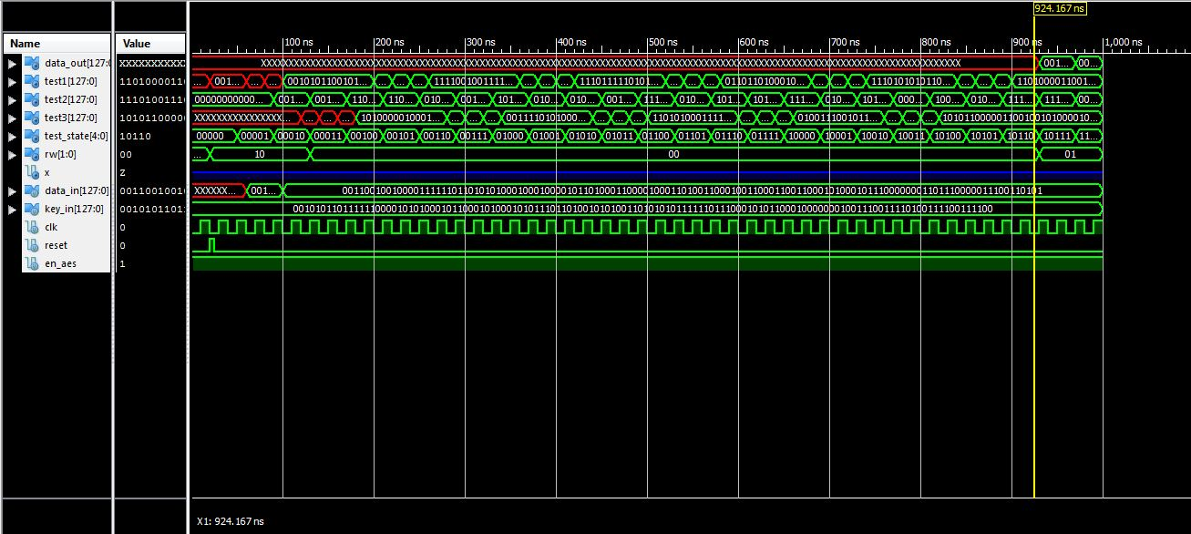
Results
Waveform for cipher

Slide 23
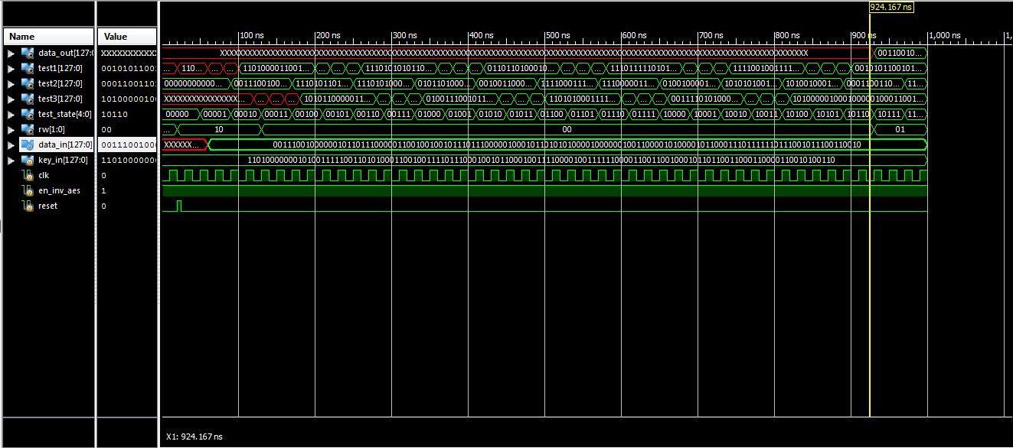
Waveform for inverse cipher

Slide 24
Tools Used
Xilinx ISE design suit v14.2.
Xilinx planahead v14.2.
Isim simulator for simulation.
Spartan 3E FPGA kit.

Slide 25
References
[1] National Institute of Standards and Technology, Advanced Encrytion Standard, Federal Information Processing Standards 197, November2001.
[2] Nadia Nedjah, Luiza de Macedo Mourelle, Marco Paulo Cardoso, "ACompact Piplined Hardware Implementation of the AES-128 Cipher, Third International Conference on Information Technology: New Generations (ITNG'06), 2006

Slide 26
Thank you

